Slide 1
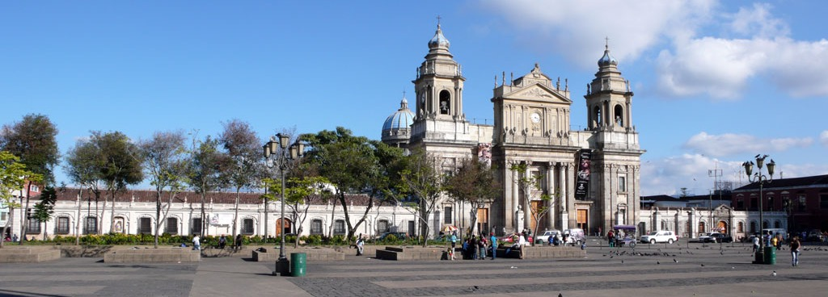

Updates and Outcomes from the Guatemalan Digitization and Encoding Project
Martha E. Thomae, Julie E. Cumming, and Ichiro Fujinaga McGill University
MEC/TEI Joint Conference: Encoding Cultures
08 September 2023
Notes:
I PRESENTED THIS PROJECT AT MEC FOUR YEARS AGO in Vienna (2019)

Slide 2
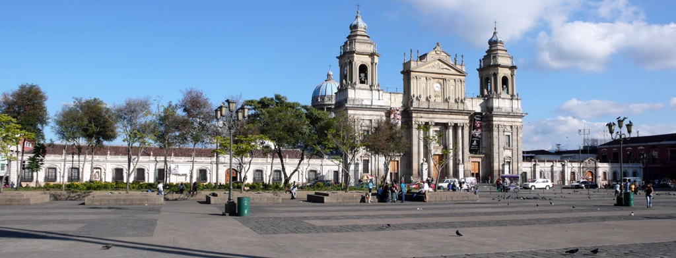
Introduction: The GuatC Collection
Collection of six polyphonic choirbooks, held at the Archivo Histórico Arquidiocesano de Guatemala (Archdiocesan Historical Archive of Guatemala, AHAG) in Guatemala City.

Slide 3
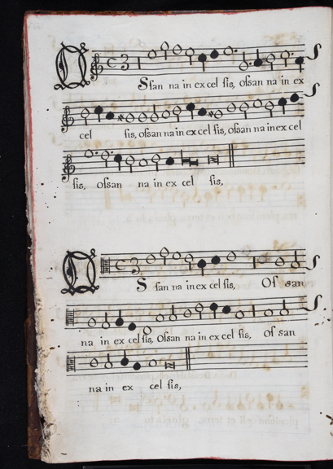
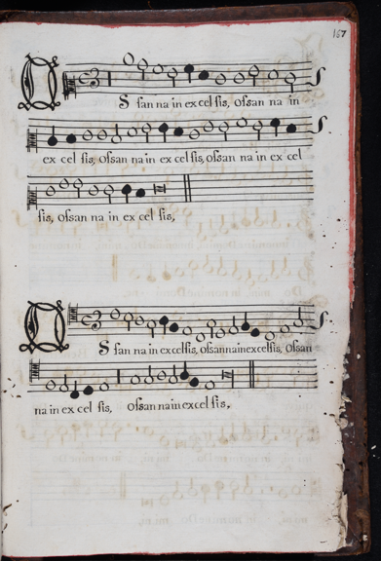
Introduction: The GuatC Collection
Collection of six polyphonic choirbooks, held at the Archivo Histórico Arquidiocesano de Guatemala (Archdiocesan Historical Archive of Guatemala, AHAG) in Guatemala City.
Superius
Alto
Manuscripts
Large dimensions
Average folio size = 30 cm x 45 cm
Book 6, size = 21.5 cm x 30 cm
Voices in choirbook format
And in mensural notation
Tenor
Bass
Notes:
[3] as shown in the left , rather than being lined up in a score
[4] system of music notation for polyphonic music used in Europe from the1250s to 1600s

Slide 4
Introduction: The GuatC Collection
Copied in the 17th and 18th centuries
Repertoire: mostly 16th c. polyphonic music
Document a continuous performance tradition of sacred choral music from the Renaissance through the 1800s
Good for studying the transmission of music from Europe to Latin America
Notes:
Importance in terms of historical and music-cultural aspects

Slide 5
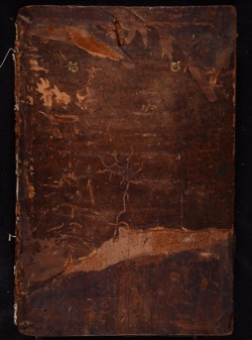
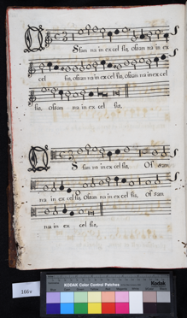
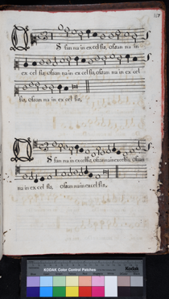
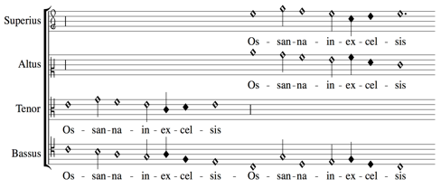
Introduction: The Project
Goal: Preserve and increase access to this music corpus by using digitization and music-encoding technologies
Pilot project: The first choirbook (GuatC 1) –> Book of Masses
playback
automatic transcription into modern values
comparison to concordant sources
Manuscript
MEI Score interpreted durations, an issue in mensural notation
Digital images
of the mensural pieces
Notes:
Accessible to the general public, modern musicians, and interesting for experts

Slide 6
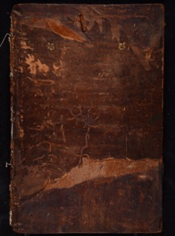

Methodology: Three-Step Process
Digitization
Optical music recognition (OMR)
Automatic voice alignment & editorial correction
MEI Score file
interpreted durations
Manuscript
Notes:
THESE WERE THE ORIGINAL THREE STEPS I THOUGHT OF FOUR YEARS AGO, AND TOOK FORM DURING THE COURSE OF THE PROJECT

Slide 7


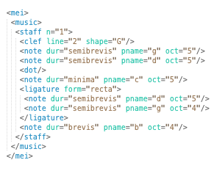
Methodology: Three-Step Process
Digitization
Optical music recognition (OMR)
Automatic voice alignment & editorial correction
MEI Score file
interpreted durations (i.e., alteration & imperfection)
Manuscript
MEI Parts file encodes the symbols in each part/voice of the images
Digital images
Notes:
3 STEPS SINCE 4 YEARS AGO
Digitization → photographing the folios
Optical Music Recognition (OMR) → Optical Character Recognition (OCR) → when you have images of a text document, you use OCR to make the images machine-readable, so the text is actually searchable
Symbolic file encoding the symbols
Pitch + note shape → of the symbols in each part.
But we are dealing with mensural notation, encoding the symbols (the pitch and note shape is not enough)
We need to encode imperfections and alterations to provide the full information regarding the note duration and to obtain a score properly lined up
Therefore, we need a THIRD step that will do that
The third step actually consists of two parts:
the automatic voice alignment part, that automatically assigns the notes a perfect / imperfect / altered value (following the Principles of Imp. & Alt of mensural notation)
And an editorial correction part. To properly line up the piece you also need to correct any scribal errors. So, this part will allow to correct these and encode both readings (the original and the corrected one)
This is how you have your digital score.

Slide 8
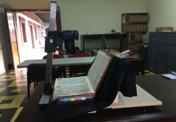


Methodology: Three-Step Process
Digitization
Optical music recognition (OMR)
Automatic voice alignment & editorial correction
MEI Score file
interpreted durations (i.e., alteration & imperfection)
Manuscript
MEI Parts file encodes the symbols in each part/voice of the images
Digital images
Notes:
Tools behind the scenes
=======================
For the symbolic files we used MEI (this is a music format that allows to encode written music in early notations, including neumes and mensural notation)
Rendered by Verovio. [DISPLAY]
=======================
HOW I THOUGHT TO DO IT 4 YEARS AGO, WHICH TOOLS I ENDED UP USING

Slide 9
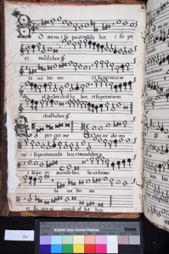
Digitization Do-it-yourself (DIY) book scanner
Digitization
Optical music recognition (OMR)
Automatic voice alignment & editorial correction
Manuscript
Digital image
Notes:
Given that these are large volumes of a special collection → the digitization requires special equipment
Book scanners

Slide 10
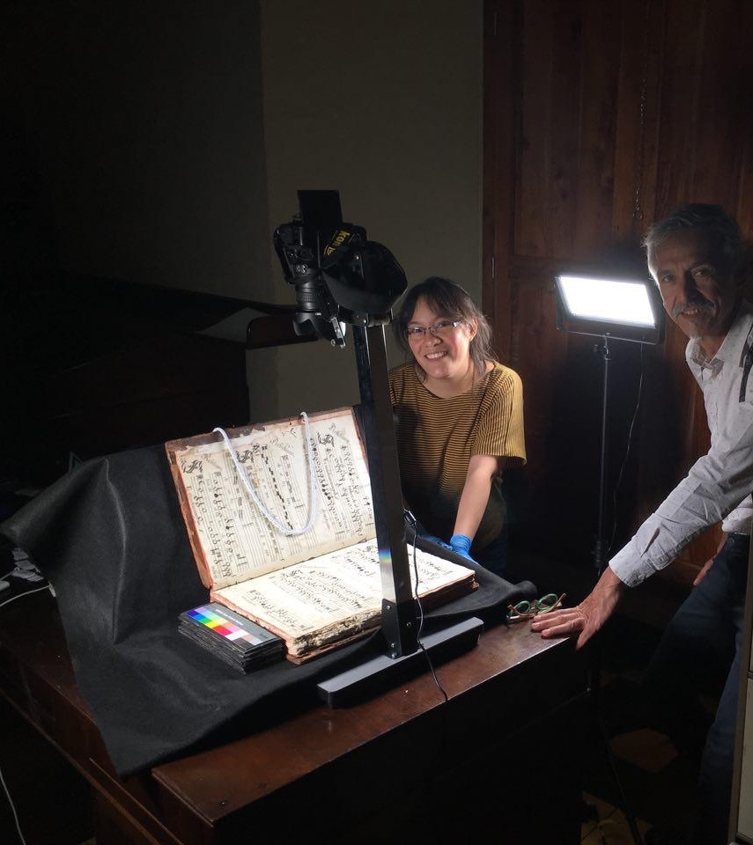
Technology Used
DIY Book Scanner
Advice from various institutions including the Digital Image Archive of Medieval Music (DIAMM)
With borrowed (camera & lights) and built parts (cradle)
with professional photographer Daniel Hernández-Salazar
Notes:
Borrowed parts: camera, copystand that holds the camera, and lights

Slide 11
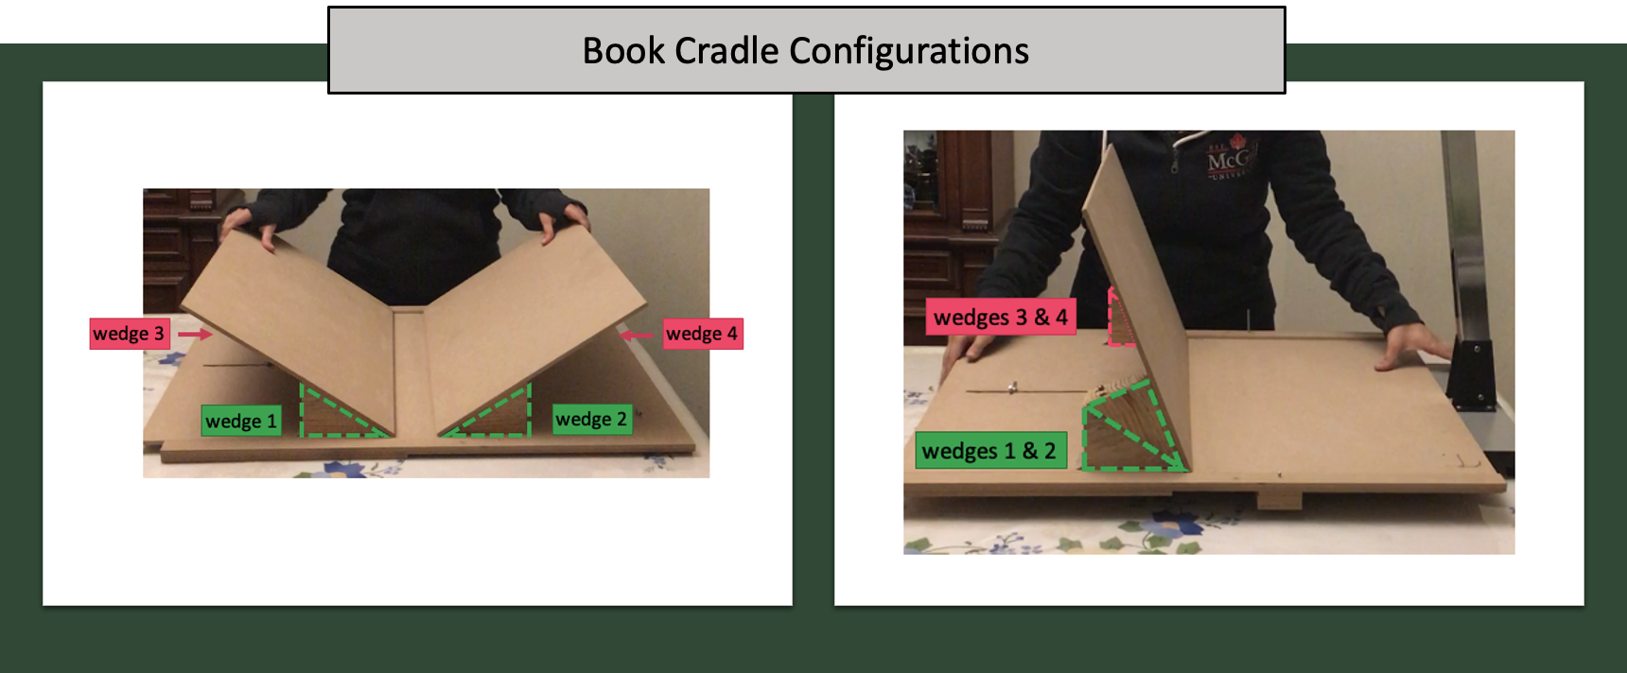
Technology Used
German Thomae
Notes:
CRADLE → FATHER BUILT IN GUATEMALA OUT OF WOOD

Slide 12
Digitization Stage
AFFORDABLE
Equipment: Do-it-yourself (DIY) book scanner
Digitization task: Conducted by me with a professional photographer hired for a few of sessions (setting camera parameters)
Conservation task: Outsourced to non-profit institution
with professional photographer Daniel Hernández-Salazar

Slide 13
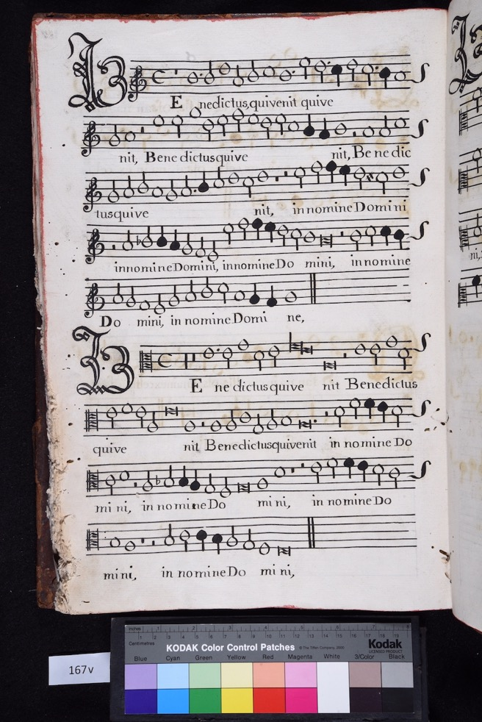
Results

Slide 14


Slide 15
Optical Music Recognition (OMR) MuRET (Music Recognition Encoding and Transcription)
Digitization
Optical music recognition (OMR)
Automatic voice alignment & editorial correction
Digital image
MEI Parts file encodes the symbols in each part/voice of the images

Slide 16
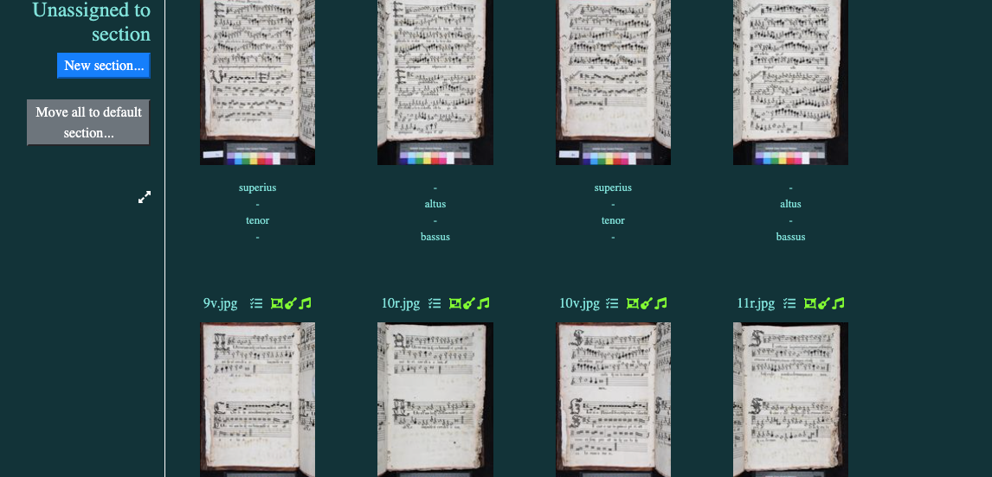

MuRET
Optical music recognition framework that supports mensural notation
Developed by David Rizo, University of Alicante
Notes:
MuRET, an optical ...
developed by David Rizo from University of Alicante

Slide 17
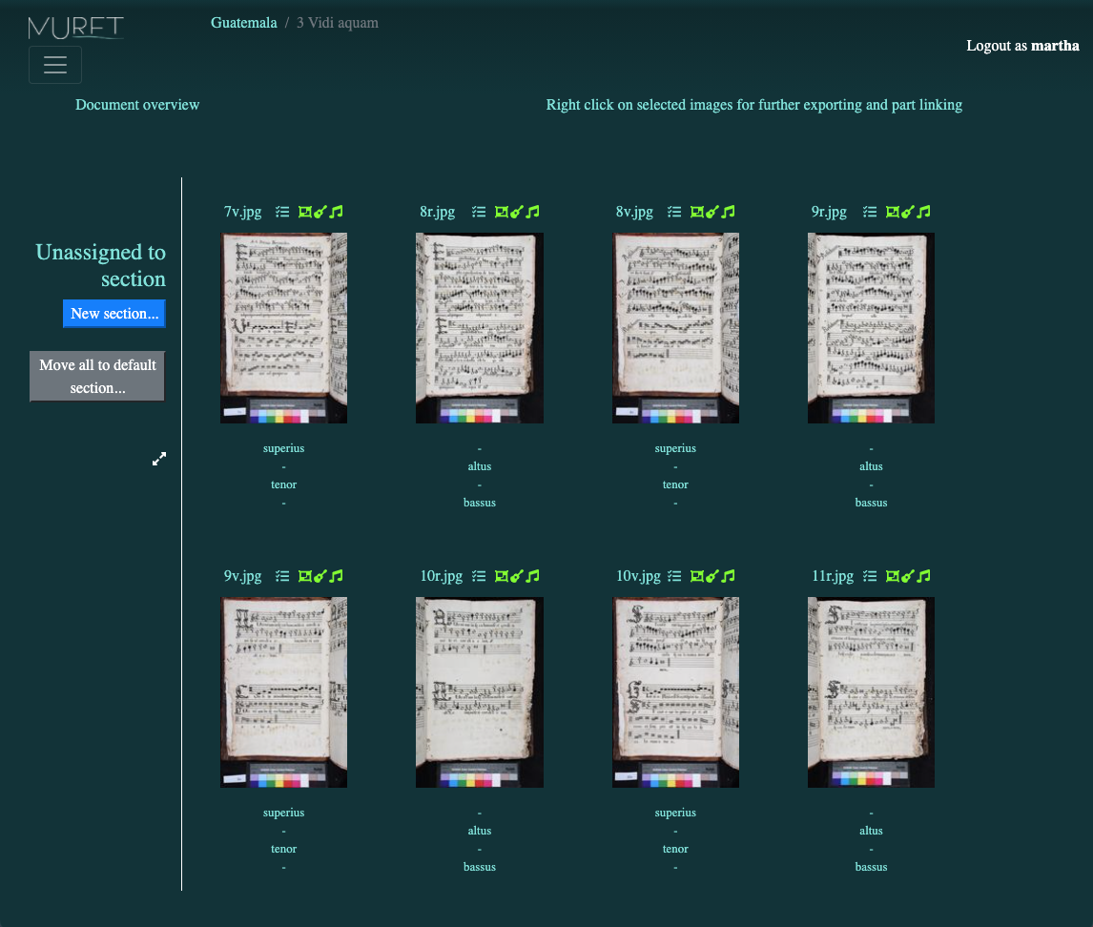
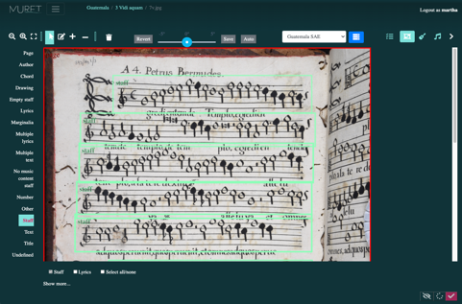
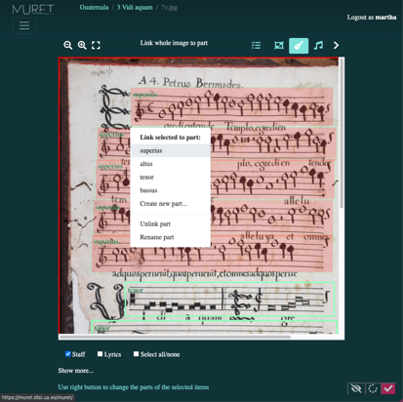
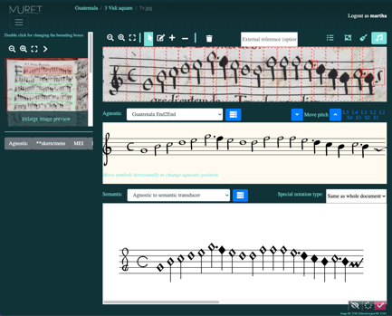

Slide 18
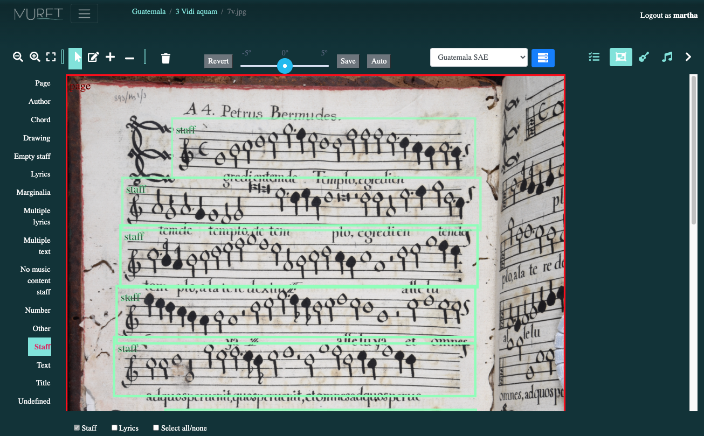
Notes:
Doc. Analysis
- Common preprocessing stage in OMR
- Ask MuRET --> staff regions (AUTOMATICALLY)
- Those staff regions will be used in the following steps

Slide 19
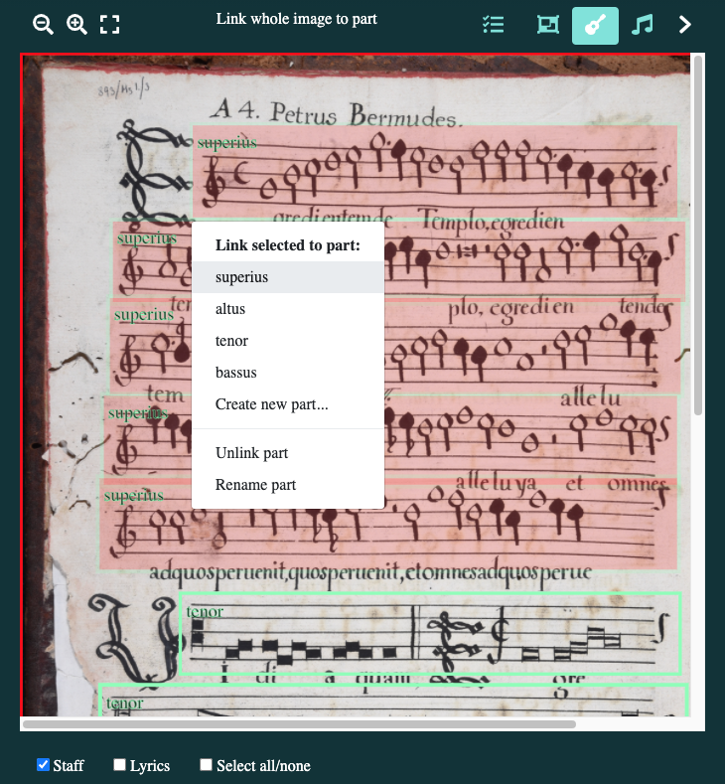

Slide 20
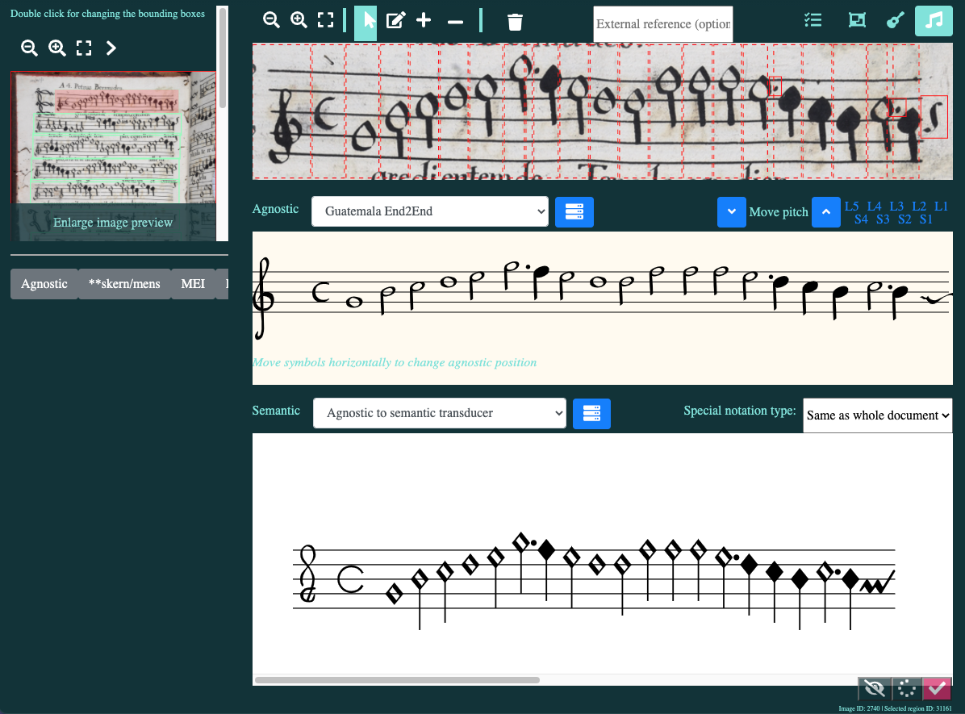
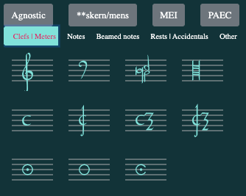

Slide 21



Slide 22
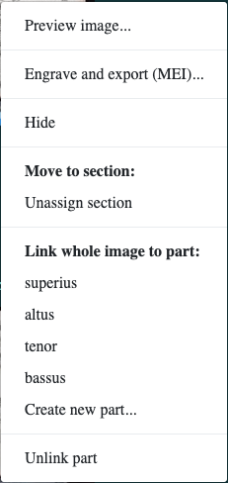

Slide 23



Automatic Voice Alignment & Editorial Correction Measuring Polyphony Editor (MP-Editor)
Digitization
Optical music recognition (OMR)
Automatic voice alignment & editorial correction
MEI Score file
interpreted durations (i.e., alteration & imperfection)
MEI Parts file encodes the symbols in each part/voice of the images

Slide 24
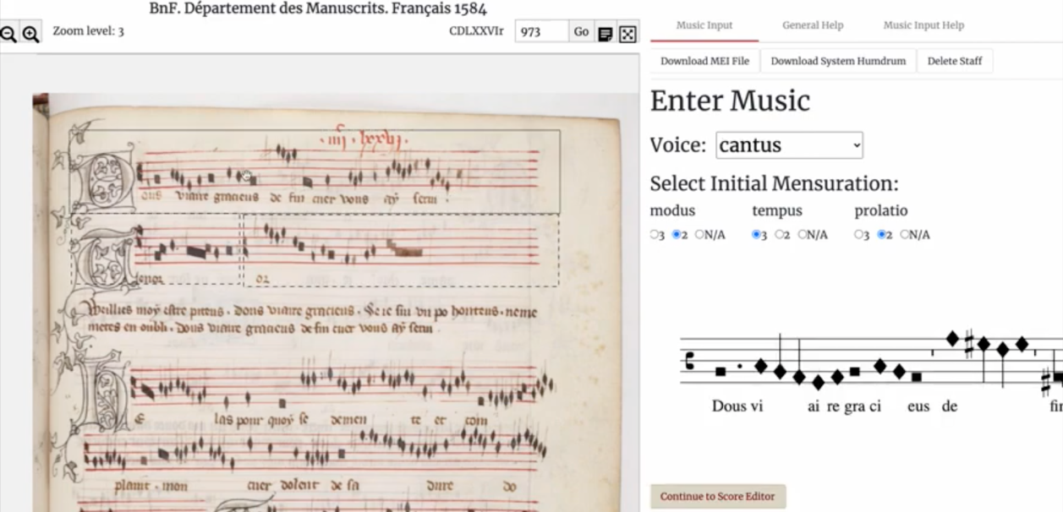
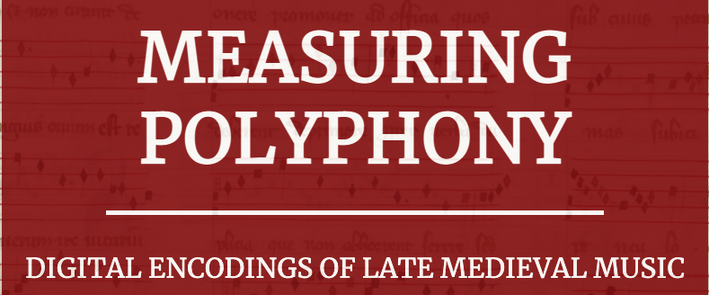
Measuring Polyphony Editor
Online editor for mensural notation
Karen Desmond (PI), Brandeis University
Notes:
PI is Prof. Karen Desmond
And the developers are actually from McGill, we have... [CLICK]

Slide 25
Measuring Polyphony Editor
Online editor for mensural notation
Mostly developed at McGill University:
Juliette Regimbal (lead developer)
Martha E. Thomae (automatic voice alignment function)
And with Laurent Pugin (Verovio), Craig Sapp (Humdrum), and Andrew Hankinson (IIIF)
Notes:
Juliette Regimbal → lead developer of this editor
Me! → I implemented the automatic voice alignment part of the editor which you will see in a moment

Slide 26
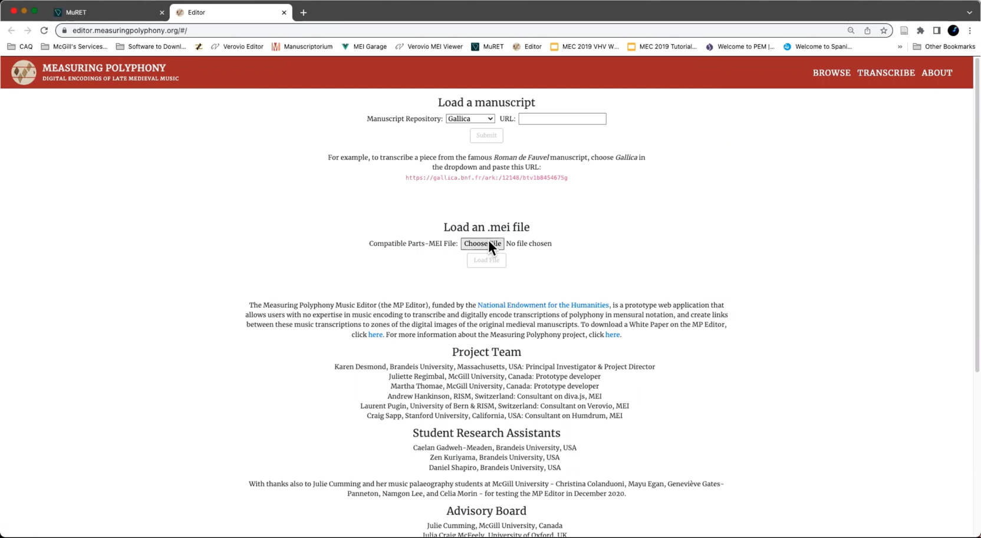
Notes:
The mp-editor can be used without OMR or with OMR
The mp-editor can be used from scratch, uploading a manuscript and entering all of the notes in a piece by typing them
Or upload an MEI file that has already all the notes encoded, like the one generated by the OMR
- This is the way that I am using it (uploading an MEI file [Missa16.4_Sanctus2_166v-167r_mpeditor])

Slide 27
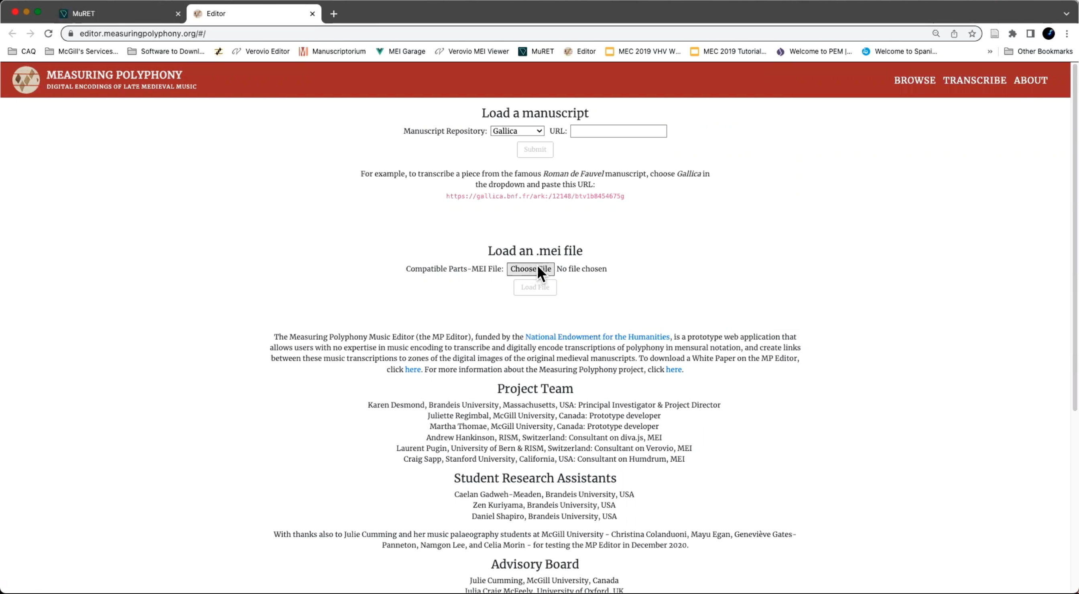
Notes:
The mp-editor can be used without OMR or with OMR
The mp-editor can be used from scratch, uploading a manuscript and entering all of the notes in a piece by typing them
Or upload an MEI file that has already all the notes encoded, like the one generated by the OMR
- This is the way that I am using it (uploading an MEI file [Missa16.4_Sanctus2_166v-167r_mpeditor])

Slide 28
Notes:
The mp-editor can be used without OMR or with OMR
The mp-editor can be used from scratch, uploading a manuscript and entering all of the notes in a piece by typing them
Or upload an MEI file that has already all the notes encoded, like the one generated by the OMR
- This is the way that I am using it (uploading an MEI file [Missa16.4_Sanctus2_166v-167r_mpeditor])

Slide 29
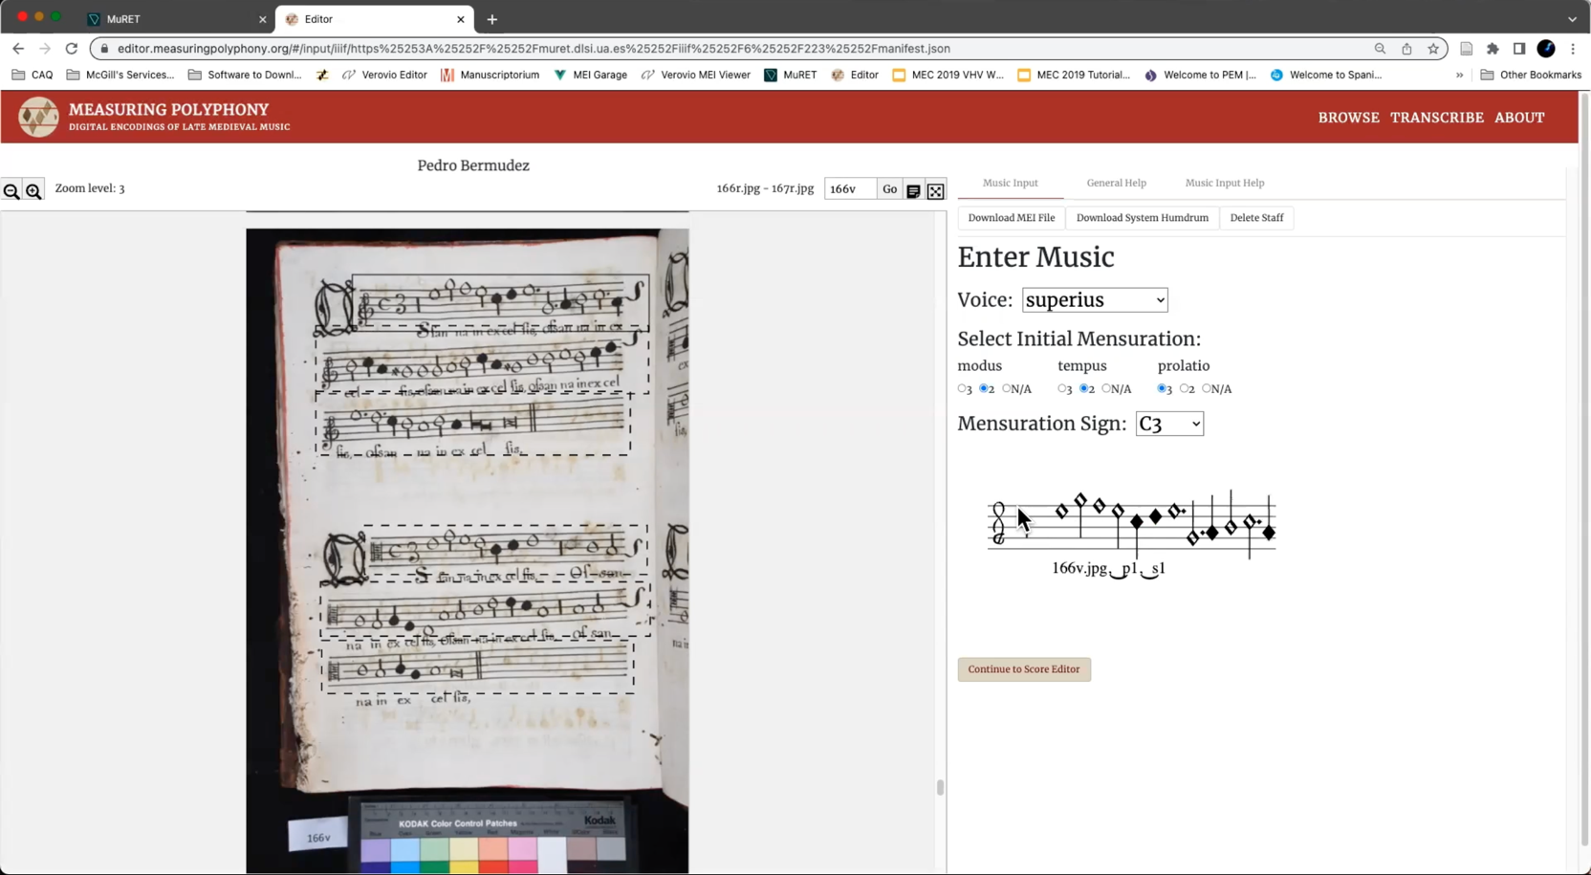
Notes:
You have all the symbols coming from the OMR |
again, you are free to input all the notes from scratch, but we don't need it in this case because the notes are present in the file coming from the OMR
So, let’s move into the next step: the score editor!
---
Automatically lines up the voices for you.

Slide 30

Notes:
You have all the symbols coming from the OMR |
again, you are free to input all the notes from scratch, but we don't need it in this case because the notes are present in the file coming from the OMR
So, let’s move into the next step: the score editor!
---
Automatically lines up the voices for you.

Slide 31
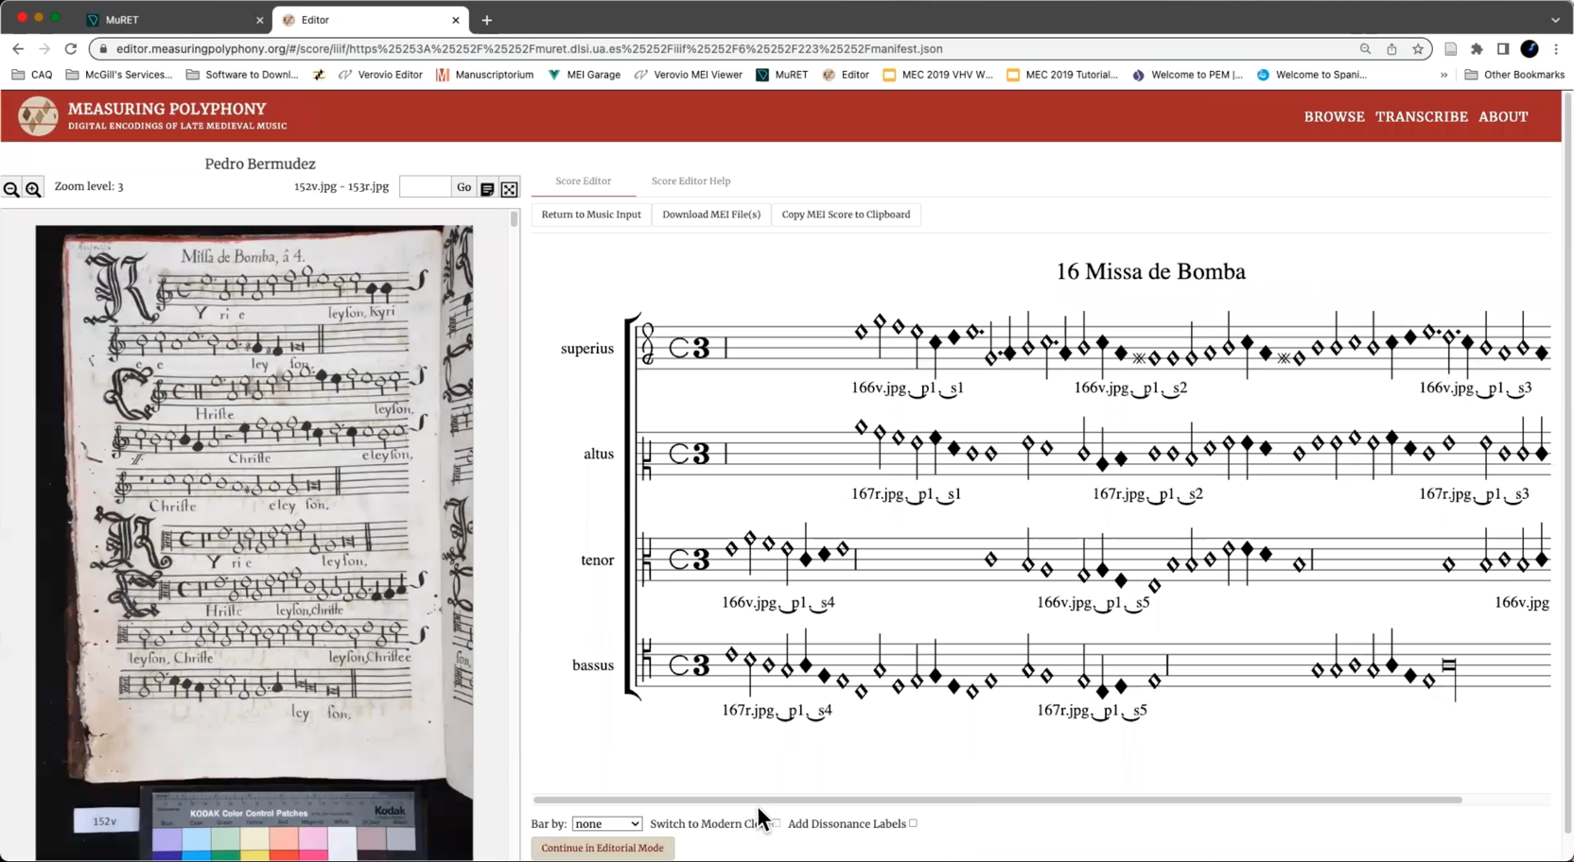
Notes:
Automatically lines up the voices for you.
---
(> Options below)

Slide 32
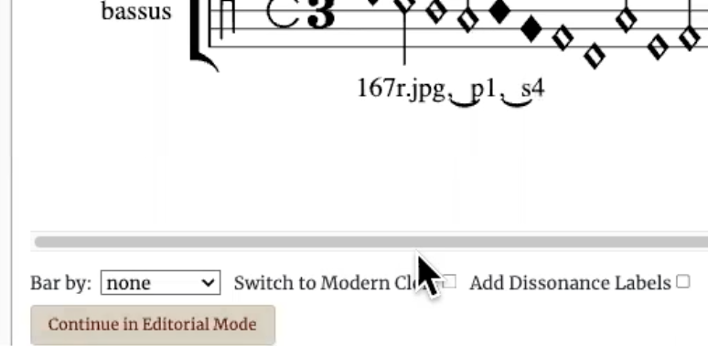
Notes:
Bar by

Slide 33
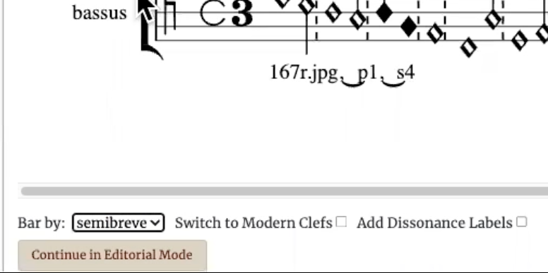
Notes:
Bar by

Slide 34
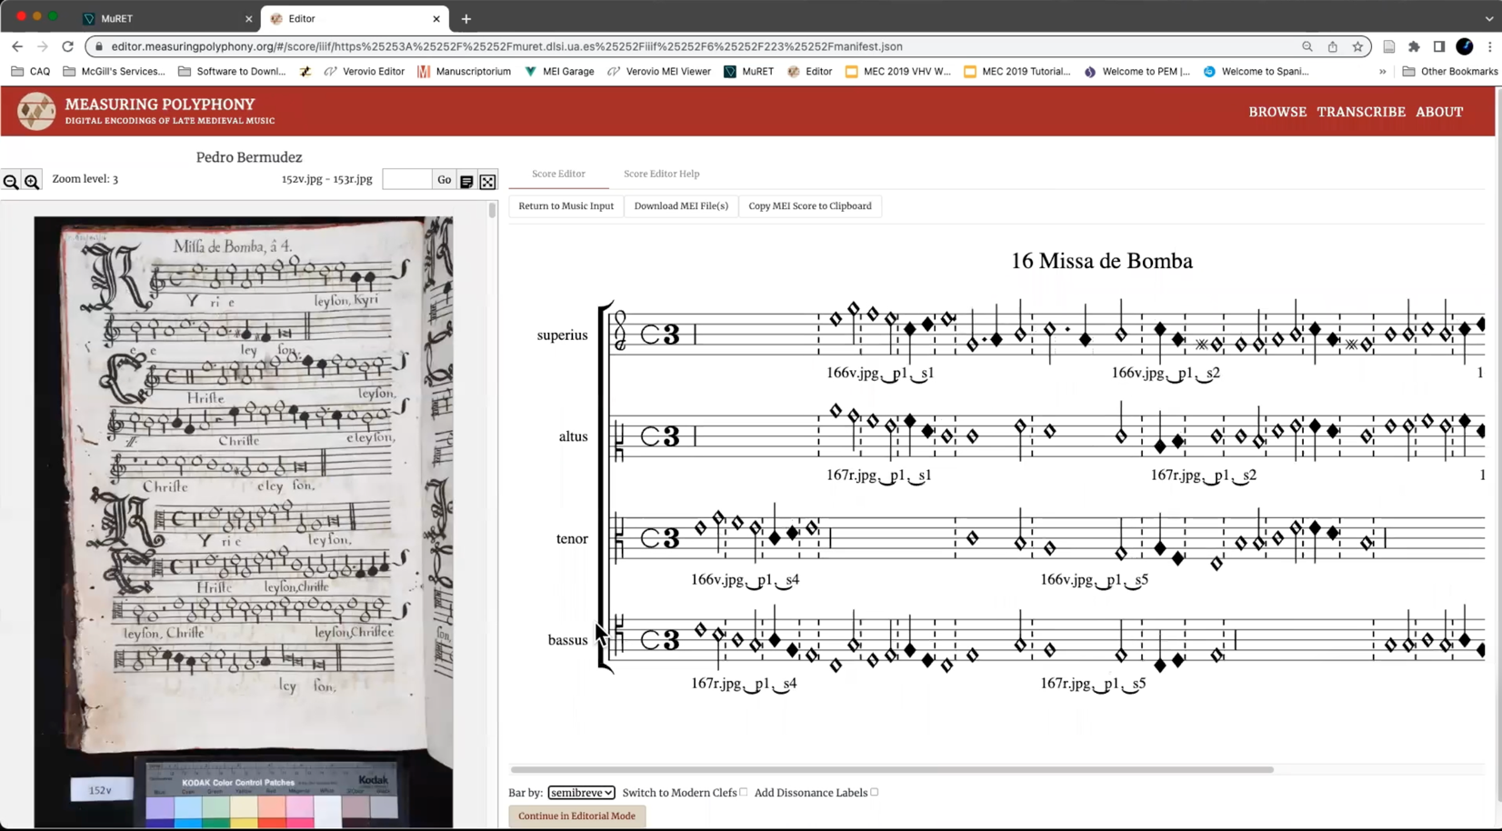
Notes:
Bar by
---
> Update of voice alignment when correcting notes

Slide 35
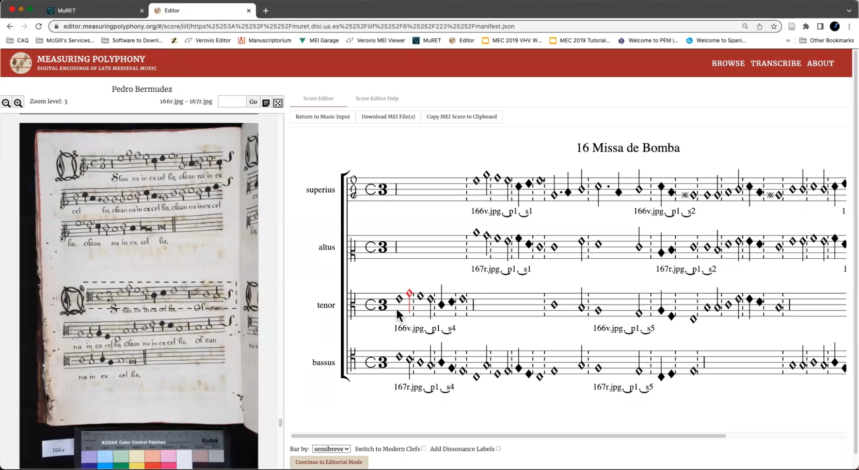
Notes:
Select a note
change its pitch (move it up and down)
change its note shape
---
Insert a note --> Update of voice alignment when correcting notes

Slide 36
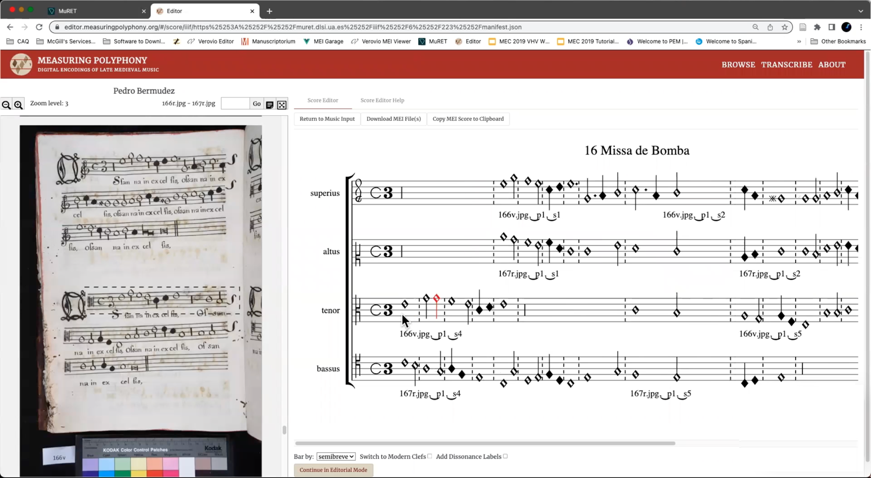
Notes:
Update of voice alignment when correcting notes

Slide 37

Notes:
Update of voice alignment when correcting notes

Slide 38

Notes:
Update of voice alignment when correcting notes
----
> For scribal errors (errors made by the scribe, not by you)
> recorded: the original reading and the corrected reading
>> Download the MEI score file with the editorial corrections

Slide 39
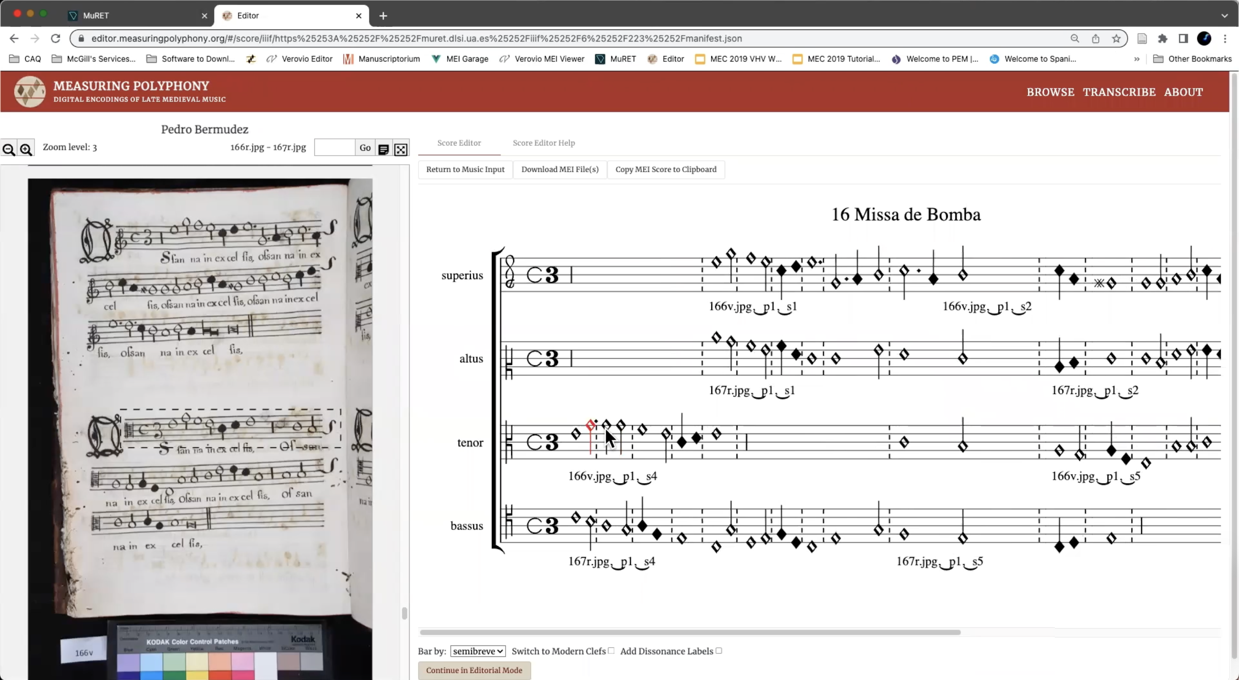
Notes:
For scribal errors (errors made by the scribe, not by you)
recorded: the original reading and the corrected reading
> Download the MEI score file with the editorial corrections

Slide 40
Notes:
For scribal errors (errors made by the scribe, not by you)
recorded: the original reading and the corrected reading
Download the MEI score file with the editorial corrections

Slide 41
Methodology: Three-Step Process
Digitization
Optical music recognition (OMR)
Automatic voice alignment & editorial correction
MEI Score file
interpreted durations (i.e., alteration & imperfection)
Manuscript
MEI Parts file encodes the symbols in each part/voice of the images
Digital images
Notes:
So, that’s the workflow!

Slide 42
Interoperability Work: MuRET & MP Editor David Rizo, Juliette Regimbal, and Martha Thomae
Digitization
Optical music recognition (OMR)
Automatic voice alignment & editorial correction
SCORE EDITOR
MEI Score file
interpreted durations (i.e., alteration & imperfection)
Digital image
MEI Parts file encodes the symbols in each part/voice of the images
Notes:
WORK ON THIS INTERSECTION !!! ANOTHER PAPER !!!

Slide 43
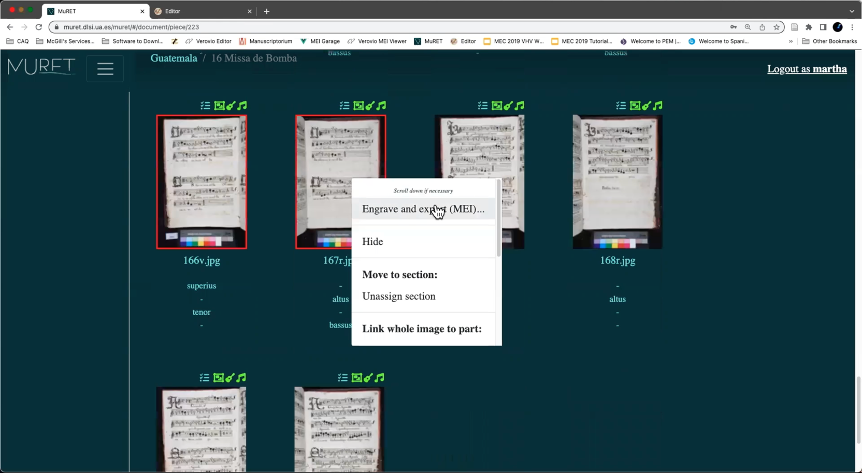

Slide 44
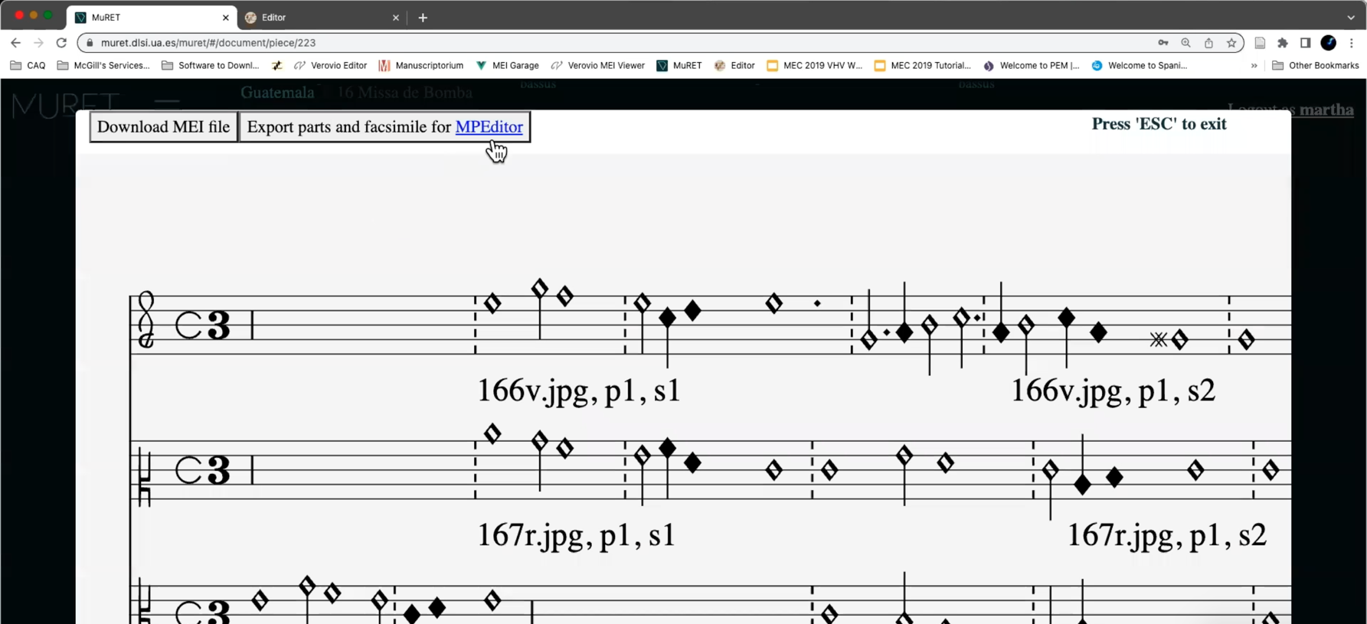

Slide 46
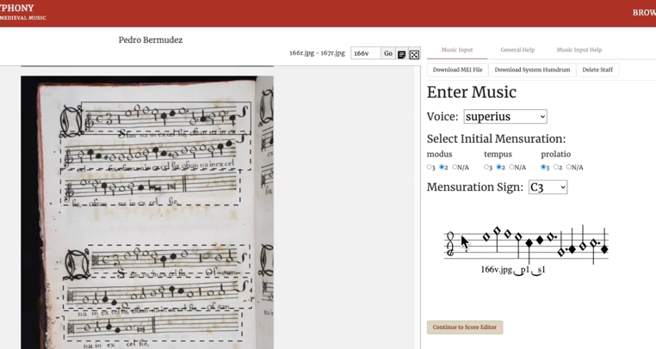
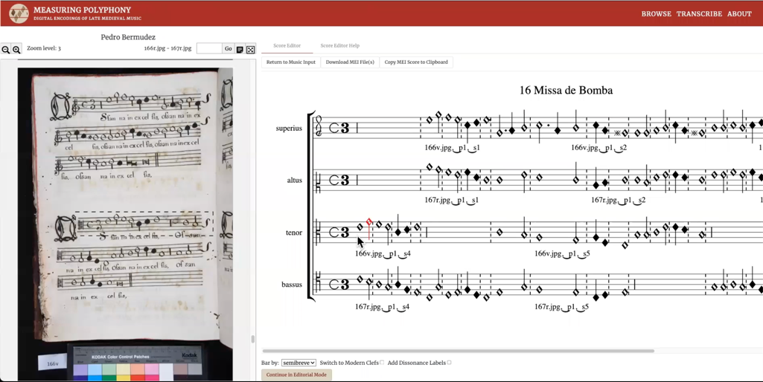
Input editor Usually a manual task
Score editor An automatic task (with manual correction)

Slide 47
Interoperability Work: MuRET & MP Editor David Rizo, Juliette Regimbal, and Martha Thomae
Digitization
Optical music recognition (OMR)
Automatic voice alignment & editorial correction
SCORE EDITOR
MEI Score file
interpreted durations (i.e., alteration & imperfection)
Digital image
MEI Parts file encodes the symbols in each part/voice of the images
Notes:
WORK ON THIS INTERSECTION !!! ANOTHER PAPER !!!

Slide 48
Interoperability Work: Humdrum DF & MP Editor Craig Sapp, Juliette Regimbal, and Martha Thomae
Digitization
Optical music recognition (OMR)
Automatic voice alignment & editorial correction
SCORE EDITOR & Humlib’s Dissonant Filter (DF)
MEI Parts file encodes the symbols in each part/voice of the images
MEI Score file
interpreted durations (i.e., alteration & imperfection)
Digital image
Notes:
Editorial corrections: detect scribal errors?
Maybe marking counterpoint errors → integration of Humlib (a library for Humdrum) dissonant filter

Slide 49
Notes:
Marking “illegal dissonances” would facilitate the correction of the scoring up?

Slide 50
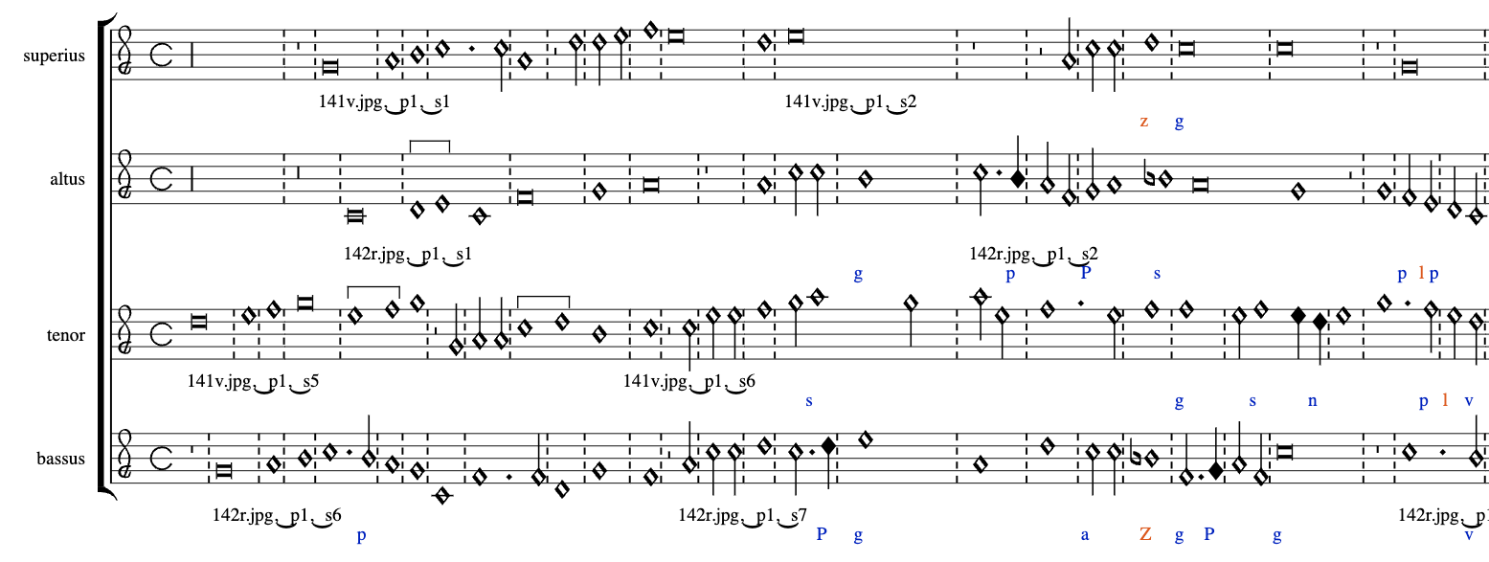

Slide 51
P/p: rising/downward passing tone
N/n: upper/lower neighbor tone
s: suspension
g: agent
Z/z: unclassified dissonance (2nd or 7th / 4th)
l: unclassified dissonance in parallel accompaniment
MP Editor with “legal” and “illegal” dissonances
(labels come from humlib’s dissonant filter,
developed by Alex Morgan and Craig Sapp for the Josquin Research Project)
Notes:
LEGAL dissonances are MARKED in BLUE: passing tones [click], neighbour tones [click], suspensions [click], and agents of those suspensions [click]
ILLEGAL dissonances, on the other hand, are MARKED in ORANGE [like these ones].
These are dissonances that do not fall in any of the "legal" categories.
- - - - - -
Shows positive results
Allowing for a more focused search → reduction of correction time
And for evaluating a correction’s effect on the dissonance types → increase in accuracy of the corrections
detecting OMR errors that went unnoticed on the previous stage of the pipeline

Slide 52
Interoperability Work: Humdrum DF & MP Editor Craig Sapp, Juliette Regimbal, and Martha Thomae
Digitization
Optical music recognition (OMR)
Automatic voice alignment & editorial correction
SCORE EDITOR & Humlib’s Dissonant Filter (DF)
MEI Parts file encodes the symbols in each part/voice of the images
MEI Score file
interpreted durations (i.e., alteration & imperfection)
Digital image
Notes:
Work to facilitate editorial correction of the scores
---
NOW, MOVING TO RESULTS AND CONTRIBUTIONS

Slide 53


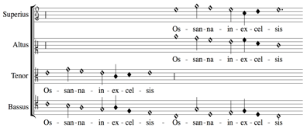
Results
1. Files:
Digital images (DIAMM)
Mensural MEI files encoding the separate parts and the scores (GitHub)
playback
automatic transcription into modern values
DIY book scanner
MuRET & MP-Editor
Digital scores Encoded in machine-readable files (MEI)
comparison to concordant sources
Manuscript
Digital image

Slide 54
Results
Workflow:
Allows for the semi-automatic transcription of mensural music from digital images of manuscripts in mensural notation
Applicable to other mensural music sources
It considers the use of DIY tools and free, online, and open software to be as accessible as possible to institutions with limited resources
playback
automatic transcription into modern values
DIY book scanner
MuRET & MP-Editor
Digital scores Encoded in machine-readable files (MEI)
comparison to concordant sources
Manuscript
Digital image
Notes:
workflow reused by other communities around the globe
who have collections in need of preservations
But have limited resources

Slide 55
Results and Contributions
Case study in the use of open-source tools in music digitization and encoding
Example of bringing projects and researchers together for a common goal
Contributed to the development of various mensural-notation projects of the Music Encoding Community
MuRET, MP Editor, Humdrum **mens and humlib
Improve individual tools
Allow for their interoperability
Reusability of this digitization and encoding method by other scholars, archives, and libraries
Pedagogical use and involvement of students in preservation of these books

Slide 56
Papers Regarding this Work
Digitization: Thomae, Martha E., Julie E. Cumming, and Ichiro Fujinaga. "Digitization of Choirbooks in Guatemala." In Proceedings of the 9th International Conference on Digital Libraries for Musicology, pp. 19-26. 2022.
Measuring Polyphony Editor (MP Editor) & Scoring Up: Desmond, Karen. "Next Steps for Measuring Polyphony: A Prototype Editor for Encoding Mensural Music." In Music Encoding Conference 2020. 2020.
Interoperability work – MuRET (OMR) and Dissonance Filter integration into the MP Editor: Desmond, Karen, Laurent Pugin, Juliette Regimbal, David Rizo, Craig Sapp, and Martha E. Thomae. "Encoding Polyphony from Medieval Manuscripts Notated in Mensural Notation." (2022).
Dissonant Filter use in the MP Editor: Thomae, Martha E., Julie E. Cumming, and Ichiro Fujinaga. "Counterpoint error-detection tools for optical music recognition of Renaissance polyphonic music." In Proceedings of the 23rd International Society for Music Information Retrieval Conference (ISMIR). 2022.

Slide 57
Acknowledgements
This collaborative project would not have been possible without the support from:
Archivo Histórico Arquidiocesano de Guatemala (AHAG) for granting permission for the project
Omar Morales Abril, Guatemalan musicologist that provided me with advice and information about the choirbooks
Alejandro Conde, AHAG’s archivist that supported and facilitated the project
José German Thomae Villela for constructing the cradle
Darryl Cameron for lending the copystand
Daniel Hernández-Salazar for setting the camera parameters
Distributed Digital Music Archives and Libraries (DDMAL) Lab at McGill University for lending the lights and other parts of the equipment
Marvin Duchow Music Library at McGill University for lending the camera
Centro de Rescate, Estudio y Análisis Científico del Arte (CREA) for the conservation assessment of the collection and the conservation treatment of the choirbook
Notes:
Finally, I would like to acknowledge all the people and institutions that helped me on the various stages of this project

Slide 58
Acknowledgements
Julia Craig-McFeely and Lynda Sayce (DIAMM), Jessica Régimbald, Marie-Chantal Anctil, and Michel Legendre (BAnQ), and Gregory Houston (McGill Library) for their advice regarding digitization and conservation of special collections
David Rizo, Karen Desmond, and Juliette Regimbal who made possible for MuRET and the MP-Editor to communicate with one another
Craig Stuart Sapp whose work allowed for the dissonance labels to be displayed in the MP-Editor
Jorge Calvo-Zaragoza, Francisco Castellanos, Antonio Ríos Vila, and José Manuel Iñesta who developed the models used in MuRET
Laurent Pugin for his work on Verovio
Alexander Morgan for his Renaissance dissonance labeler script
Peter Schubert for his expert advice in counterpoint matters
Geneviève Gates-Panneton for her work in the experiment
My supervisors: Julie Cumming and Ichiro Fujinaga

Slide 59











Thank you!
martha.thomaeelias@mail.mcgill.ca
Notes:
THANKS TO ALL OF YOU FOR YOUR ATTENTION!
------------------------------
Digitization phase
Getting to the other side of the book
Curvature of the page to be photographed → sol.
Book closing abruptly → sol.
Failing of software
Tethering, official software, hard drives
Folio numbering
Have to come up with a small workflow (series of steps) to make the digitization process as mechanic as possible
The page falling and the increase in curvature when reaching the other end of the book
Lack of numbers on versos: Printed numbers
------------------------
OMR issues
Easier next time as the same scribe for other pieces (and now we have a model trained in the whole book)
Model for doc. analysis too
------------------------
Mp-editor issues
Something that avoids the input interface altogether (or more support for the conversion between MEI and Humdrum within the mp editor) because some information gests lost.
------------------------

